Slide 1
FLIGHT DATA INTEGRATION
AND
SEARCH ENGINE
By:
Gowtham Tumati
Lovepreet Singh Dhaliwal
Abhishek Ayachit
Sudip Bala

Slide 2
MOTIVATION
There was difficulty in finding one flight dataset which can be considered as Big Data.
The data is available at:
https://transtats.bts.gov/ONTIME/Departures.aspx
But no APIs are available.

Slide 3
GOAL
To collect data from multiple users who used the mentioned website as their source and integrate the data.
Application of the cleaned data:
Search Engine on the Big Data

Slide 4

CONTENTS
1. Data Collection
2. Data Cleaning and Integration
3. Search Engine
4. Visualization of Search Results

Slide 5
DATA COLLECTION
BTS Website:
https://transtats.bts.gov/ONTIME/Departures.aspx
Collected Data:

Slide 6
CONTENTS
1. Data Collection
2. Data Cleaning and Integration
3. Search Engine
4. Visualization of Search Results

Slide 7
Data Cleaning and Integration
Removing Unnecessary fields
Changing the attributes into one format
Filling Missing Values
Integrating Data into one file
Dropping Values for ranking Airlines

Slide 8
CONTENTS
1. Data Collection
2. Data Cleaning and Integration
3. Search Engine
4. Visualization of Search Results

Slide 9

Search Engine
Notes:
Asterix DB

Slide 10
CONTENTS
1. Data Collection
2. Data Cleaning and Integration
3. Search Engine
4. Visualization of Search Results

Slide 11

STANDARD SEARCH API EXAMPLE
curl --request GET --url 'https://api.twitter.com/1.1/search/tweets.json?q=<MentionSearchQuery>&result_type=mixed&count=2'
--header
'authorization: OAuth oauth_consumer_key="consumer-key-for-app",
oauth_nonce="generated-nonce", oauth_signature="generated-signature",
oauth_signature_method="HMAC-SHA1", oauth_timestamp="generated-timestamp",
oauth_token="access-token-for-authed-user", oauth_version="1.0"'

Slide 12

One of the major attractions of Spark is the ability to scale computation massively, and that is exactly what we need for our project utilizing machine learning algorithms.
Standard implementations of machine learning algorithms require very powerful machines to be able to run and depending on high-end machines is not advantageous due to their high price and improper costs of scaling up.
The idea of using a distributed computing engine like spark is to distribute the calculations to multiple low-end machines instead of a single high-end one. This definitely speeds up the learning phase and allows us to create better models.

Slide 13

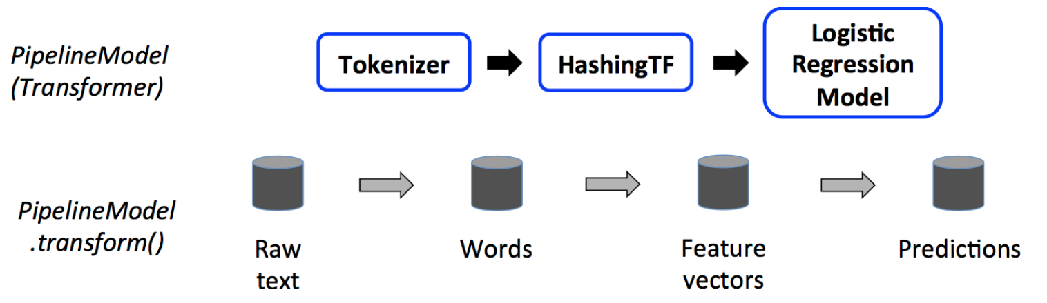
MLlib is Spark’s machine learning (ML) library. Its goal is to make practical machine learning scalable and easy. It provides tools such as: ML Algorithms: common learning algorithms such as classification, regression, clustering, and collaborative filtering.

Slide 14
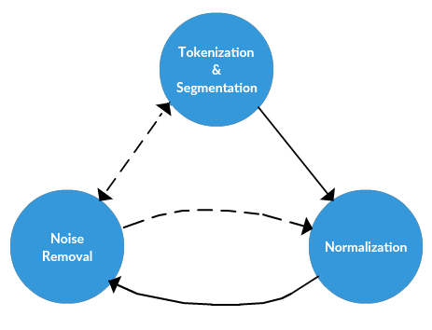
Preprocessing Text
Source:KDnuggets

Slide 15
Tokenization and segmentation
Tokenization is the task of chopping text up into pieces, called tokens
n-gram is a contiguous sequence of n items from a given sample of text or speech eg of a tri-gram: 6 inch phone
Noise Removal
Stopword removal
Punctuation, special characters removal
Normalization
CountVectorizer
TF-IDF vectorizer
Word Embeddings

Slide 16
MACHINE LEARNING MODEL

Slide 17
Regression Analysis: Estimates relationships between a dependent - independent variable(s)
Dependent Variable (Yes/ No)
For Eg. Will someone get a loan?
Independent Variable
For Eg. Credit Score
If our result is binary, then, we want to see what makes it changes from NO to Yes.
→ Likelihood of result, P(YES)

Slide 18


Dependent Variable: (For Eg.)
Q. Will you vote for me?
Independent Variable: (For Eg.)
Age
YES?
NO?

Slide 19

So, should we use Linear Regression to predict the outcome?

Slide 20
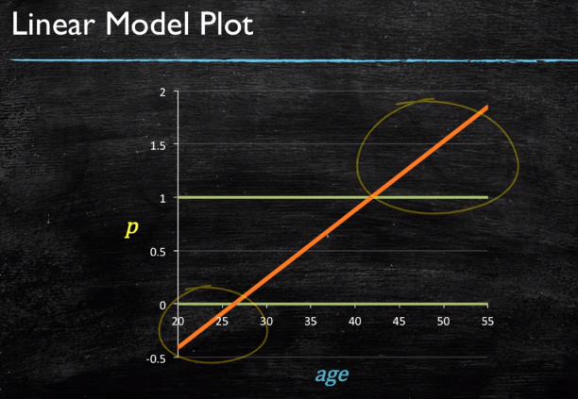
Outcome(P) = β₀ + β₁ * Age
We can’t, right?

Slide 21

Logistic Regression will save us!!!!!
Outcome(P) = exp (β₀ + β₁ * Age)
exp (β₀ + β₁ Age) + 1
Q. How should Logistic Model Plot looks?

Slide 22
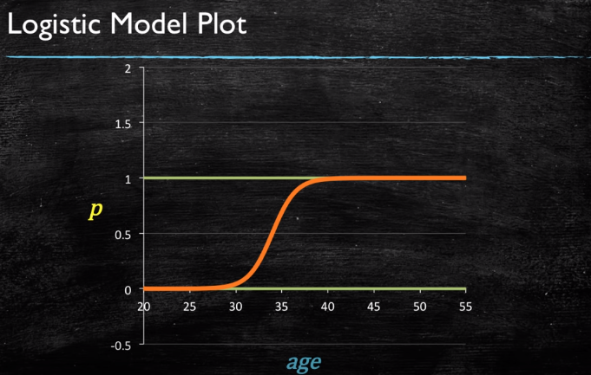

Slide 23




Implementation
Splitting the dataset to train and test data
Data pre-processing (mean =0 and SD = 1)
Training the Logistic Regression model
Prediction
Notes:
The idea behind StandardScaler is that it will transform your data such that its distribution will have a mean value 0 and standard deviation of 1. Given the distribution of the data, each value in the dataset will have the sample mean value subtracted, and then divided by the standard deviation of the whole dataset

Slide 24
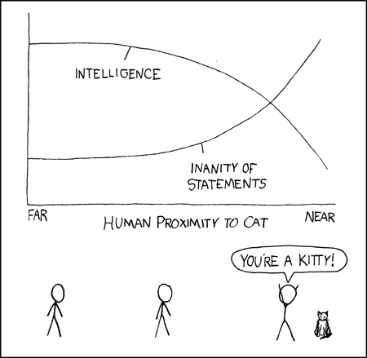
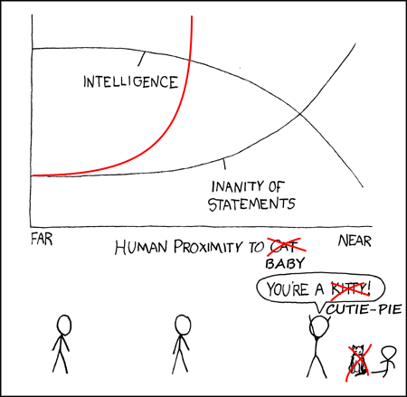
Data Visualization

Slide 25
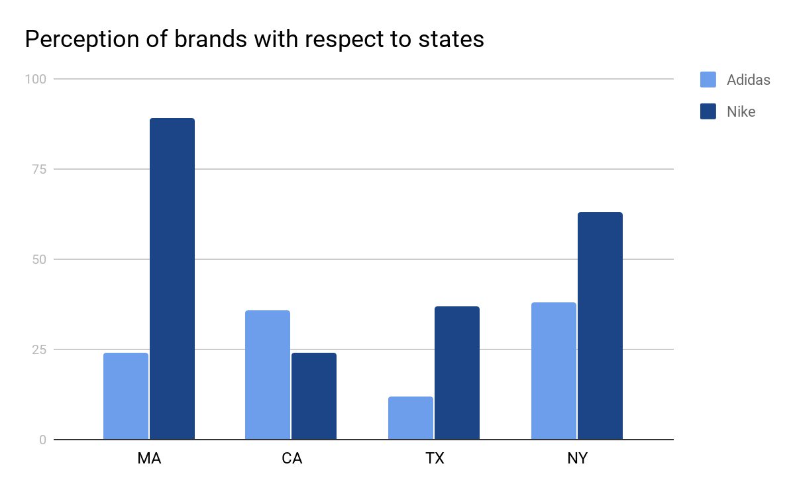
Data Visualization
Why visualization?
Identify areas that need attention or improvement.
Clarify which factors influence customer behavior.
Helps understand which products to place where.
Predict sales volume.
Graphs will be realized using matplotlib
*These graphs do not represent the actual trend of brand perception

Slide 26
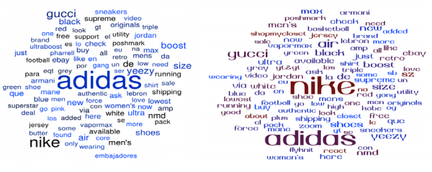
Data Visualization
Word cloud of Adidas
Word cloud of Nike
A word cloud visual represents the frequency of a word within a body of text with its relative size in the cloud. This technique is used on unstructured data as a way to display high or low frequency words.

Slide 27
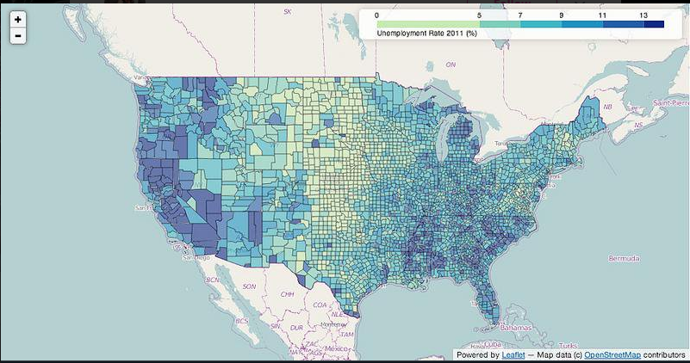
Data Visualization
Google My Maps / folium will be used to plot the map.
Two columns: one with geographical reference and the other with data.
Manipulate the data using python and visualize it on leaflet.js via folium or place the code in iFrame in case of Google My Maps.
Notes:
Folium is built on the data wrangling strengths of the Python ecosystem and the mapping strengths of the Leaflet.js (JavaScript) library.

Slide 28
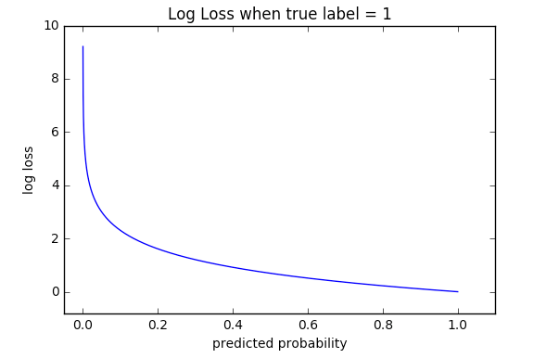

Evaluation Metric: Log-Loss
It measures the performance of a classification model where the prediction input is a probability value between 0 and 1.
The goal of our machine learning models is to minimize this value. A perfect model would have a log loss of 0. Log loss increases as the predicted probability diverges from the actual label.
Log loss is defined as:
where N is the number of samples or instances, M is the number of possible labels, Yij is a binary indicator of whether or not label j is the correct classification for instance i, and Pij is the model probability of assigning label j to instance i.

Slide 29

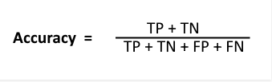
Evaluation Metric: Confusion Matrix
 | Class 1 Predicted | Class 2 Predicted
Class 1 actual | True Positive | False Negative
Class 2 actual | False Positive | True Negative
Implementation:
Notes:
The confusion matrix shows the ways in which your classification model is confused when it makes predictions. The number of correct and incorrect predictions are summarized with count values and broken down by each class
• True Positive (TP) : Observation is positive, and is predicted to be positive.
• False Negative (FN) : Observation is positive, but is predicted negative.
• True Negative (TN) : Observation is negative, and is predicted to be negative.
• False Positive (FP) : Observation is negative, but is predicted positive.

